Slide 1




LINES IN THE PLANE
Maximum Number of Regions Formed by n Lines
Presented by:
42230100543 - Rakibul Islam
42230100544 - Shamim mia

Slide 2
INTRODUCTION TO MAIN MEMORY
Definition: Main memory is the primary storage used by a computer to store data that is actively being used or processed by the CPU.
Importance: It allows fast data access and plays a crucial role in the overall performance of the system.
Difference: Unlike secondary storage (HDD, SSD), which is slower and used for long-term data storage, main memory is faster but temporary.

Slide 3

TYPES OF MAIN MEMORY
RAM (Random Access Memory): Temporary storage that stores data and instructions needed by the CPU.
1. DRAM (Dynamic RAM): Needs to be refreshed constantly, cheaper but slower.
2.SRAM (Static RAM): Faster, reliable, but more expensive and consumes more power.
Cache Memory: High-speed storage located close to the CPU to store frequently accessed data.
MISSION

Slide 4
LOGICAL VS. PHYSICAL ADDRESS SPACE
The concept of a logical address space that is bound to a separate physical address space is central to proper memory management
Logical address – generated by the CPU; also referred to as virtual address
Physical address – address seen by the memory unit
MEMORY-MANAGEMENT UNIT (MMU)
Hardware device that maps virtual to physical address
In MMU scheme, the value in the relocation register is added to every address generated by a user process at the time it is sent to memory

Slide 5
CONTIGUOUS ALLOCATION
Main memory usually into two partitions:
Resident operating system, usually held in low memory
User processes then held in high memory
Relocation registers used to protect user processes from each other, and from changing operating-system code and data
Base register contains value of smallest physical address
Limit register contains range of logical addresses – each logical address must be less than the limit register

Slide 6
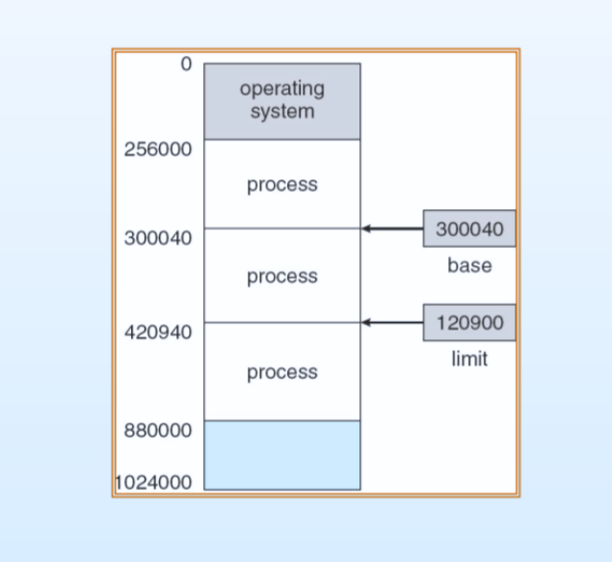
BASE AND LIMIT REGISTERS
A pair of base and limit registers define the logical address space

Slide 7

THANK
YOU
FOR WATCHING
NUB ECSE (6B)

